Slide 1
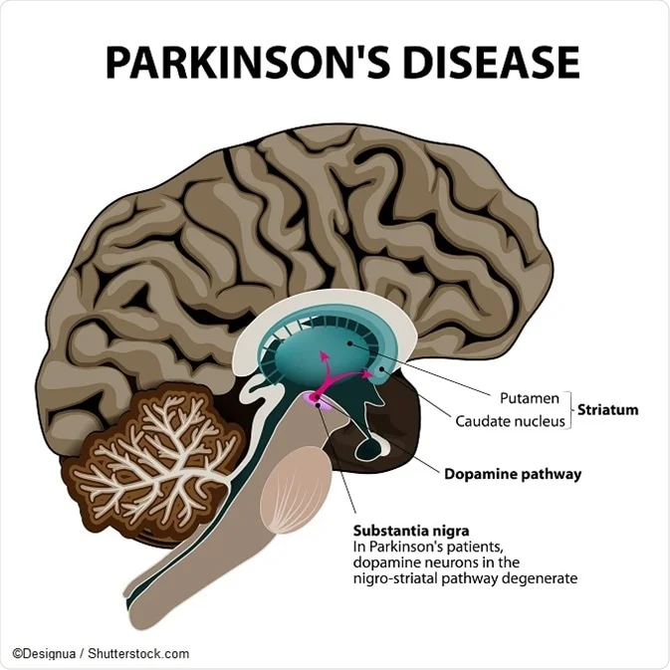
Detection of Parkinson’s Disease(PD) Using Machine Learning model Chaity Kundu

Slide 2
Goal of My Project
My main aim of this project to test the ability of motor function of the patient with Parkinson’s disease.
To represent less featured data while maintaining the ability to discriminate.
The clinical-perceptual method was used in this project to further investigate the nature of Parkinsonian speech disabilities by analyzing the speech deficit profiles (voice, articulation, and fluency) of a cross section of speech affected patients with Parkinson's disease.

Slide 3
What is Parkinson’s Disease (PD) ?
Parkinson’s Disease(PD) , the second most common disease after Alzheimer’s and a major public health problem .
It is neurodegenerative disorder that affects the neural , behavioral and psychological system of our brain . It is also known as Tremor.
The common symptoms of this disease are slowness of movement , loss of automatic movements , speech/writing changes and difficulty of working at early stages .
It affects 6 million people worldwide over the age 50.
At present there is no conclusive result for this disease by non-specialist clinicians.

Slide 4
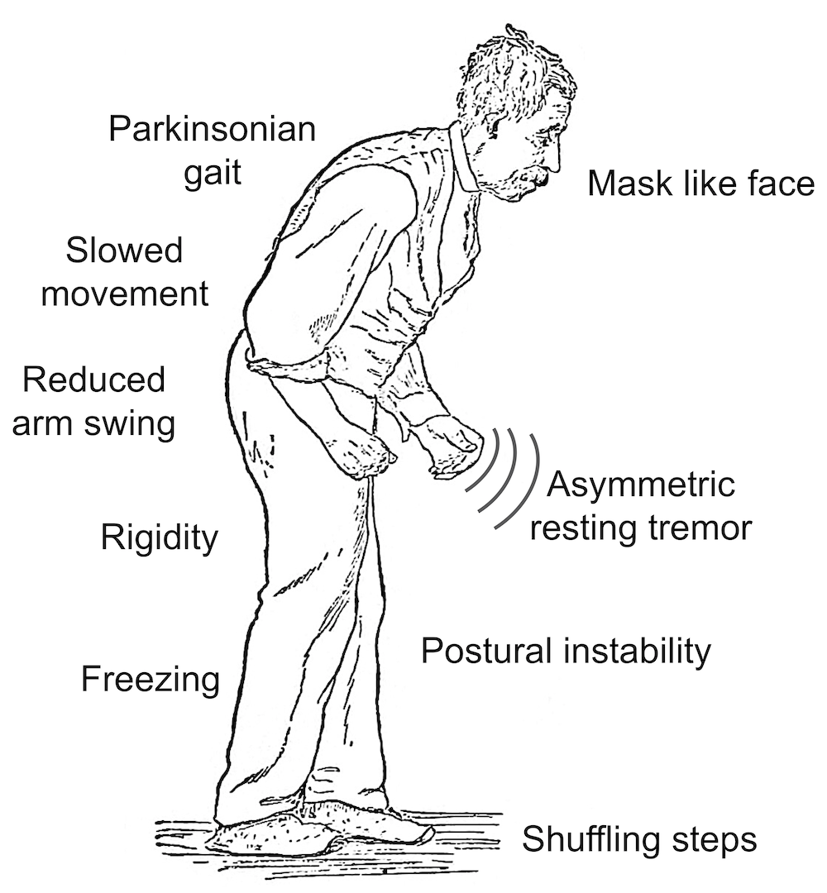
Symptoms of a Parkinson’s Patient

Slide 5
What is Machine Learning(ML) ?
Machine learning is a branch of artificial intelligence (AI) and computer science which focuses on the use of data and algorithms to imitate the way that humans learn, gradually improving its accuracy.
In my project I am using ML tools to give intelligence to our machine so that it can take decision automatically without participation of human being.

Slide 6
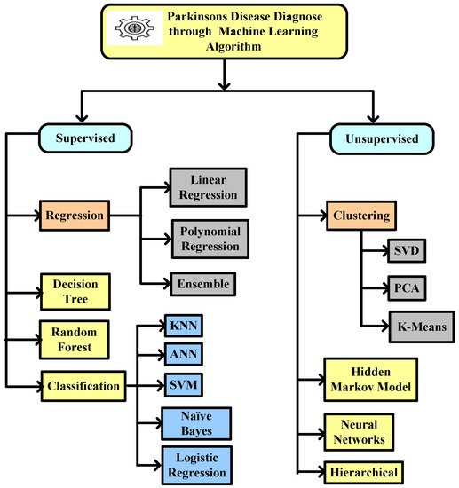
Machine Learning Tools
ML gives us different techniques:

Slide 7
Machine Learning tools which I am using in my project
In my project I am using Supervised Machine Learning Classifier.
What is XGBoost Classifier ?
XGBoost is a new Machine learning algorithm designed with speed and performance in mind.
XGBoost is stands for Xtreme Gradient Boosting and is based on decision tree.
In my project , I will import the XGB_Classifier from the XGBoost library and this is an implementation from the Scikit-Learn API.
It is showing the highest accuracy in most of the dataset.

Slide 8
Flow chart of my model to predict Parkinson’s Disease.
Data Collected from UCI DATBASE
Feature Selection
Decompose into Train & Test Dataset
XGBoost Classifier
Normal
Parkinson

Slide 9
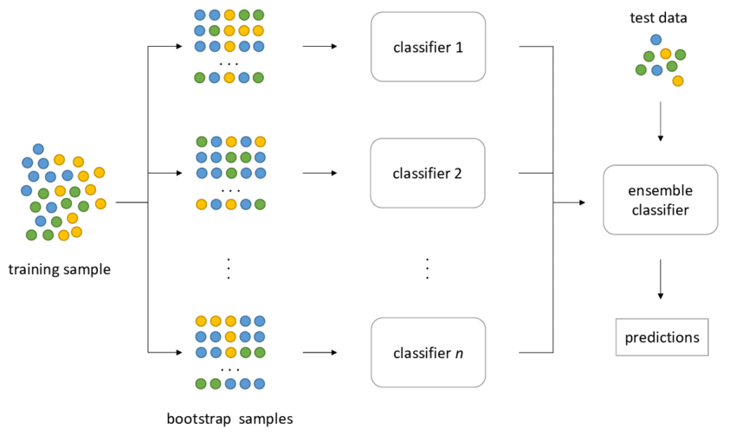
Work Flow of My predictive model

Slide 10
What is Training dataset and Testing dataset ?
In machine learning, datasets are split into two subsets. The first subset is known as the training data.
The training dataset is the biggest (in-size) subset of the original dataset , which is used to train or fit the ML model.
Firstly , the training data is fed to the ML algorithms , which lets them learn how to make predictions for the given tasks.
Once we training the model with training dataset , it’s time to test the model with the test dataset.
The test dataset is the another subset of original data , which is independent of the training dataset.

Slide 11
Materials and Dataset which I am using in my model?
My predictive model will predict Parkinson’s Disease based on voice of a human being.
For this purpose, Firstly I downloaded the UCI Machine learning library was supported by Oxford University and the National Voice and Speech Centre.
The data mostly helps to distinguish between stable and Parkinson's disease (PD) patients by using the 'Status' column, which sets the number for 0 in healthy people and 1 in PD patients.
The data is available in ASCII CSV format.

Slide 12
FEATURES AND ITS DESCRIPTION OF VOICE SIGNAL MEASURENTS
Features | Description
MDVP: F0 (Hz) | Fundamental frequency of speech on average.
MDVP: Fhi(Hz) | The fundamental pitch of the voice at its highest.
MDVP: Flo (Hz) | The fundamental pitch of the voice should be as low as possible.
MDVP: Jitter (%) | MDVP jitter expressed as a percentage
MDVP: Jitter (Abs) | MDVP absolute jitter in milliseconds.
MDVP: RAP | Modification of the relative amplitude of MDVP.
MDVP: PPQ | The five-point duration perturbation quotient of MDVP.
Jitter: DDP | The average absolute variance between jitter intervals.

Slide 13
FEATURES AND ITS DESCRIPTION OF VOICE SIGNAL MEASURENTS
Features | Description
MDVP: Shimmer | MDVP shimmer on the local level.
MDVP: Shimmer(dB) | MDVP local glow in decibels (dB).
Shimmer: APQ3 | The aptitude perturbat-ion quotient at three points
Shimmer: APQ5 | The amplitude perturbat-ion quotient at five points.
MDVP: APQ11 | The 11-point amplitude perturbation quotient of MDVP.
Shimmer: DDA | The average absolute difference in the amplitudes of successive phases.

Slide 14
FEATURES AND ITS DESCRIPTION OF VOICE SIGNAL MEASURENTS
Features | Description
NHR | Ratio of noise to harmonics.
HNR | The ratio of harmonics to noise.
RPDE | The density entropy of recurrence periods is a measure of entropy.
D2 | Dimension of correlation
DFA | Exponent of signal fractal scaling in detrended fluctuation analysis.
Spread 1 | Two nonlinear fundamental tests.
Speed 2 | Variation of frequency.
PPE | Entropy of pitch duration.

Slide 15
Why I am using XGBoost Tool ?
According to doing a lot of literatures survey , I have seen that the XGBoost Algorithm can give the more accurate result than others existing Machine Learning Algorithm.
For improved Parkinson's disease diagnosis in sufferer's voice signals, the most reliable, finest Machine learning model in which classifier XGBOOST has been used is developed for predicting the disease.
This model achieve an accuracy of approximately 93.33% in detecting Parkinson's disease.
That’s why I am choosing this Machine Learning tool in my model.

Slide 16
Future endeavour
My work is based on Machine Learning model , that is not enough for the accurate result or accuracy.
In future I want to work with deep learning model, such as recurrent neural networks (RNNs) and transformers and also comapare with the DL and ML model.
When I work with two or more models this can help me to get the best accuracy .
Researchers will also investigate the integration of multimodal data, such as facial expressions and gait analysis, to develop a more holistic diagnostic approach.
The dataset which is used a voice dataset. So in that case, for my future work I need some equipment like- high quality microphone , recording software, calibration, a good device etc.

Slide 17
Literature Survey
Title | Name of author | Year | Source
Early detection of Parkinson's disease using machine learning | Aditi Govindu , Sushila Palwe | 2023 | https://doi.org/10.1016/j.procs.2023.01.007
DETECTING PARKINSON'S DISEASE USING XGBOOST CLASSIFIER MACHINE LEARNING | Nikisha Jadhav , Sangita Phad, Snehal Kamble | 2021
Detection of Parkinson’s Disease Using XGBOOST Algorithm | Sanika Narayanpethkar , M. Rishitha, S. Chandana, Dr. T. Vijaya Saradhi | 2022 | https://doi.org/10.22214/ijraset.2022.48225
Detection of Parkinson disease using multiclass machine learning approach | Saravanan Srinivasan, Parthasarathy Ramadass, Sandeep Kumar Mathivanan, Karthikeyan Panneer Selvam, Basu Dev Shivahare & Mohd Asif Shah | 2024 | https://www.nature.com/articles/s41598-024-64004-9

Slide 18
Thank You

